Slide 1
Data Scientist Test
Applicant: Dhiren Charania

Slide 2
Part 1
Objective: Unlabelled or unclassified data using which you are expected to provide an approach to solving a particular problem using a combination of Clustering and Classification.
The data extract comprises of 3 main categories of features:
Account Features
Personal ID Features
Redemption Activity

Slide 3
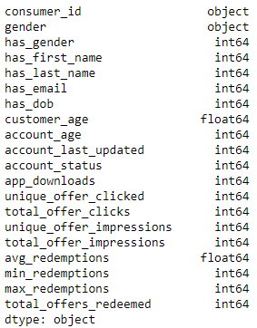
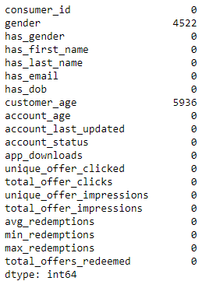
Data types

Slide 4
Data describe
 | has_gender | has_first_name | has_last_name | has_email | has_dob | customer_age | account_age | account_last_updated | account_status | app_downloads
count | 10000 | 10000 | 10000 | 10000 | 10000 | 4064 | 10000 | 10000 | 10000 | 10000
mean | 0.5478 | 0.998 | 0.9959 | 0.9992 | 0.4064 | 22.98080709 | 245.8166 | 174.2567 | 0 | 1.0322
std | 0.497734803 | 0.04467885 | 0.063903039 | 0.028274369 | 0.49118547 | 8.504063729 | 130.0906927 | 0.895145373 | 0 | 0.186993734
min | 0 | 0 | 0 | 0 | 0 | 15 | 174 | 173 | 0 | 1
25% | 0 | 1 | 1 | 1 | 0 | 19 | 184 | 174 | 0 | 1
50% | 1 | 1 | 1 | 1 | 0 | 20 | 187 | 174 | 0 | 1
75% | 1 | 1 | 1 | 1 | 1 | 24 | 193 | 174 | 0 | 1
max | 1 | 1 | 1 | 1 | 1 | 119 | 649 | 187 | 0 | 5
 | unique_offer_clicked | total_offer_clicks | unique_offer_impressions | total_offer_impressions | avg_redemptions | min_redemptions | max_redemptions | total_offers_redeemed
count | 10000 | 10000 | 10000 | 10000 | 10000 | 10000 | 10000 | 10000
mean | 3.1724 | 5.8256 | 7.5165 | 68.4299 | 1.003003333 | 1.0013 | 1.0057 | 1.8809
std | 2.059830704 | 5.290423754 | 3.490264452 | 69.59134703 | 0.046453396 | 0.036033871 | 0.079171566 | 1.187120936
min | 1 | 1 | 1 | 2 | 1 | 1 | 1 | 1
25% | 2 | 2 | 4 | 23 | 1 | 1 | 1 | 1
50% | 3 | 4 | 7 | 47 | 1 | 1 | 1 | 2
75% | 4 | 8 | 10 | 90 | 1 | 1 | 1 | 2
max | 14 | 62 | 25 | 1693 | 2.5 | 2 | 4 | 11

Slide 5
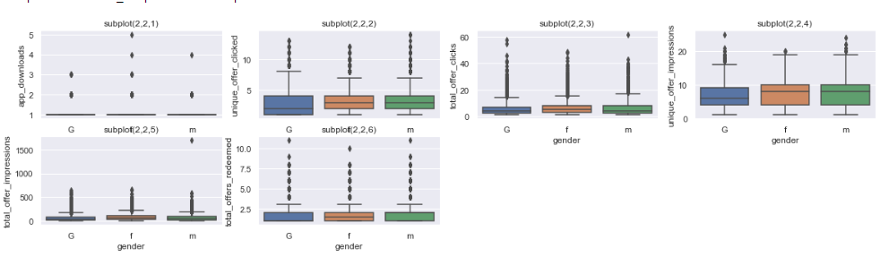
Boxplot

Slide 6
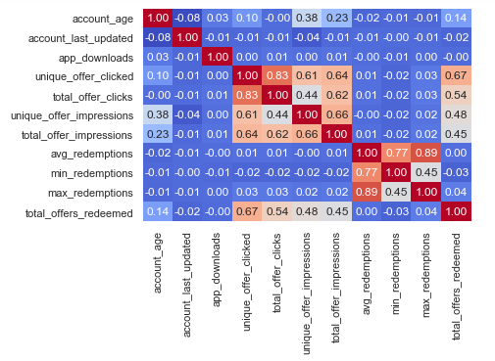
Corrplot
Unique_offer_clicked is strongly correlated with total_offer_clicks

Slide 7
K-means clustering
The objective of K-means is simple: group similar data points together and discover underlying patterns. To achieve this objective, K-means looks for a fixed number (k) of clusters in a dataset.

Slide 8
Dropping columns
'consumer_id',
'has_gender',
'has_first_name',
'has_last_name',
'has_email',
'has_dob',
'customer_age',
'account_status’,
'gender',
'unique_offer_clicked',
'unique_offer_impressions',
'min_redemptions',
'max_redemptions'

Slide 9
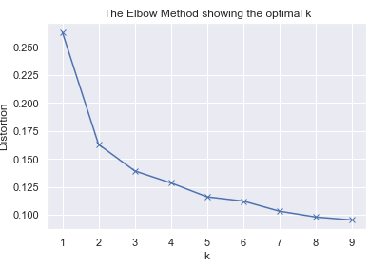
Scaling the data and Elbow method plot
Use MinMaxScaler() to scale the data and transform it to array
After scaling I have used K = 1 to 10 for generating K number of clusters
As seen K =2 has turned slightly however it is not very strong

Slide 10
After selecting K =2, we have run the program on K means clustering on dataset.
From the 10000 customer, there are 1575 fraud cases.
Silhouette score is highest for K=2 (0.68)
Description of predicted value

Slide 11
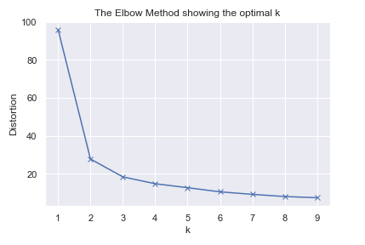
PCA for data transform and reploting the elbow method
I have also tried PCA to reduce the dimension and re-ploted the elbow method
The plot show sharp turn at K=2

Slide 12
After selecting K =2, we have run the program on K means clustering on dataset.
From the 10000 customer, there are 1594 fraud cases.
Silhouette score is highest for K=2 (0.87) and it has improved compared to last one
Description of predicted value

Slide 13
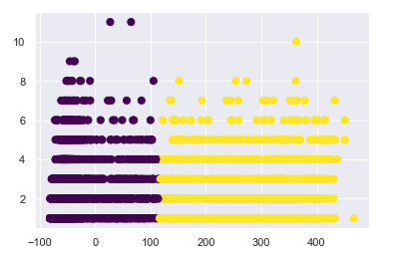
Scatter plot of fraud and genuine account
Here the blue colour data is fraud cases

Slide 14
Random Forest Classifier
Now I have applied Random Forest Classifier for classification of dataset.
A random forest algorithm does is that it creates multiple decision trees and merges them together to obtain a more stable and accurate prediction.
Our dataset is large and unlabelled or unclassified. From our previous Clustering method, we found that data has roughly (1:5) fraud accounts.

Slide 15
Approach
I have split the dataset into train and test data in the ration (0.7:0.3).
R-Code:
clf=RandomForestClassifier(n_estimators=100, random_state=123,class_weight="balanced")
Results:
Accuracy : 0.519
Mean Absolute error : 0.67

Slide 16
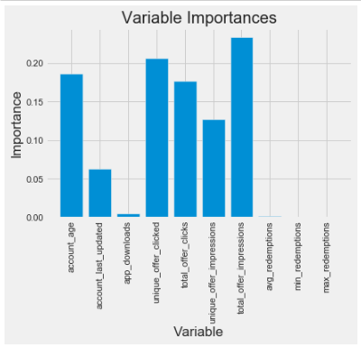
Variable Importance

Slide 17
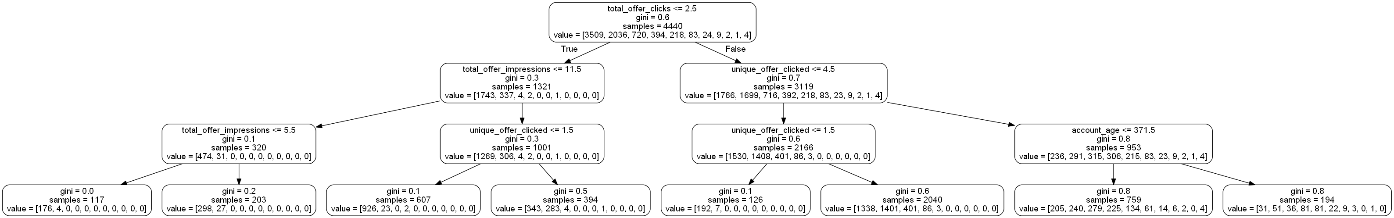
One tree plot pulled out with depth= 3

Slide 18
Part 2
Objective: Time series data analysis to provide an approach to solving a marketing mixed model.

Slide 19
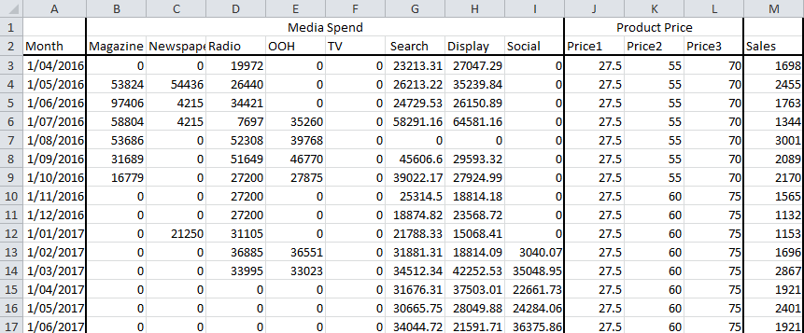
Dataset
Rows | Columns
35 | 13

Slide 20
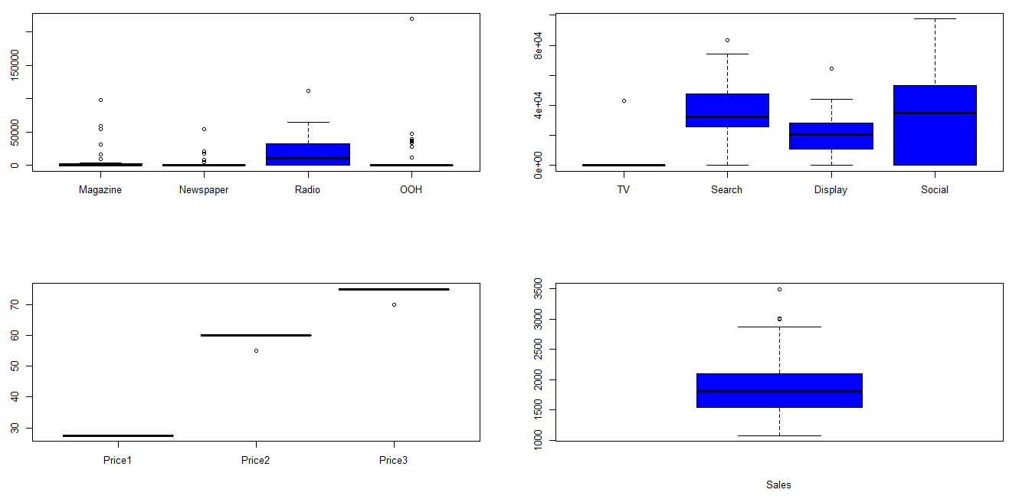
Boxplot

Slide 21
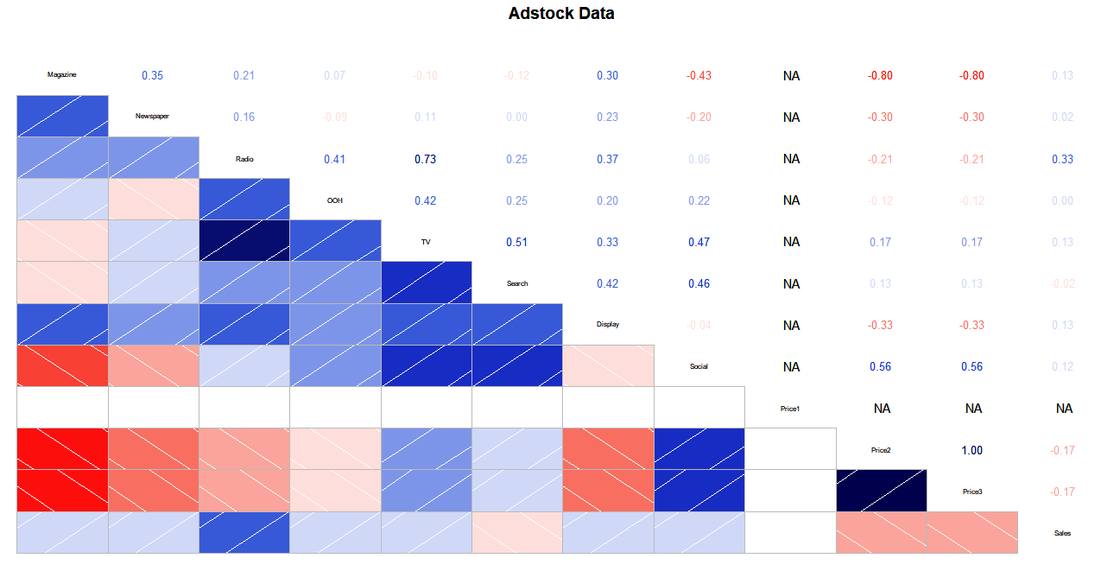
Corrplot

Slide 22
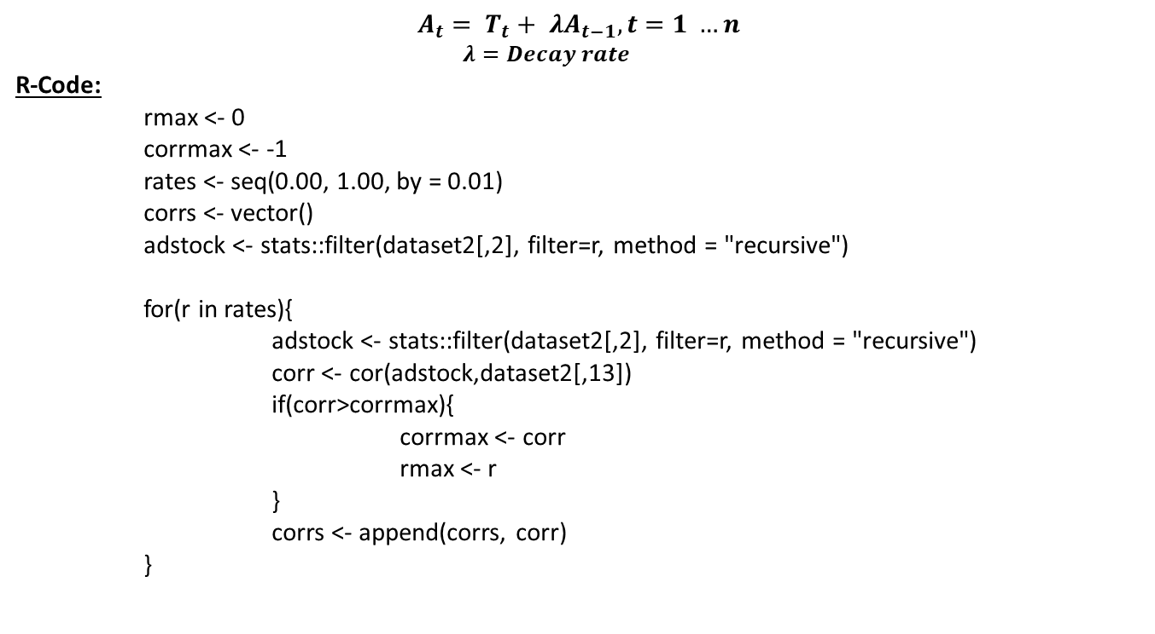
Adstock Decay rate calculation
$$A_{t}= T_{t}+ λA_{t−1}, t=1 …n$$
$$λ=Decay rate$$
R-Code:
rmax <- 0
corrmax <- -1
rates <- seq(0.00, 1.00, by = 0.01)
corrs <- vector()
adstock <- stats::filter(dataset2[,2], filter=r, method = "recursive")
for(r in rates){
adstock <- stats::filter(dataset2[,2], filter=r, method = "recursive")
corr <- cor(adstock,dataset2[,13])
if(corr>corrmax){
corrmax <- corr
rmax <- r
}
corrs <- append(corrs, corr)
}

Slide 23
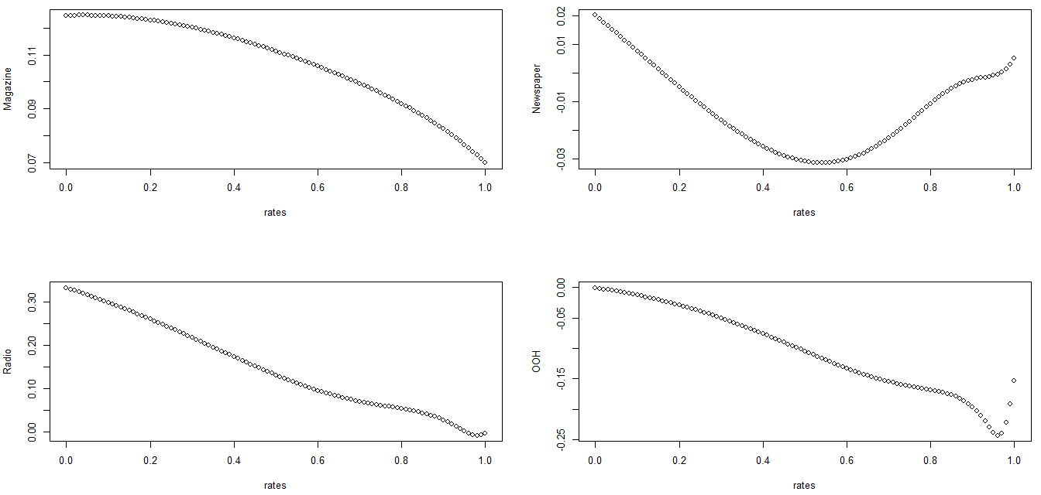
1) Media vs Decay rates

Slide 24
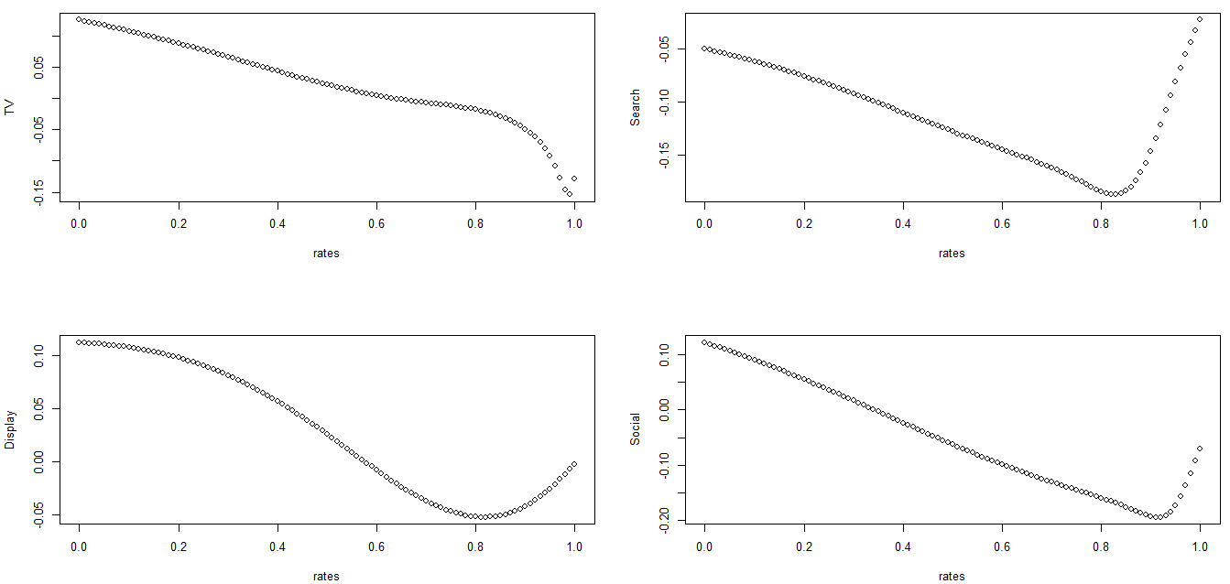
2) Media vs Decay rates

Slide 25
Decay Rate
Adstock | Decay Rate
Magazine | 0.04
Newspaper | 0
Radio | 0
OOH | 0
TV | 0
Search | 1
Display | 0
Social | 0

Slide 26
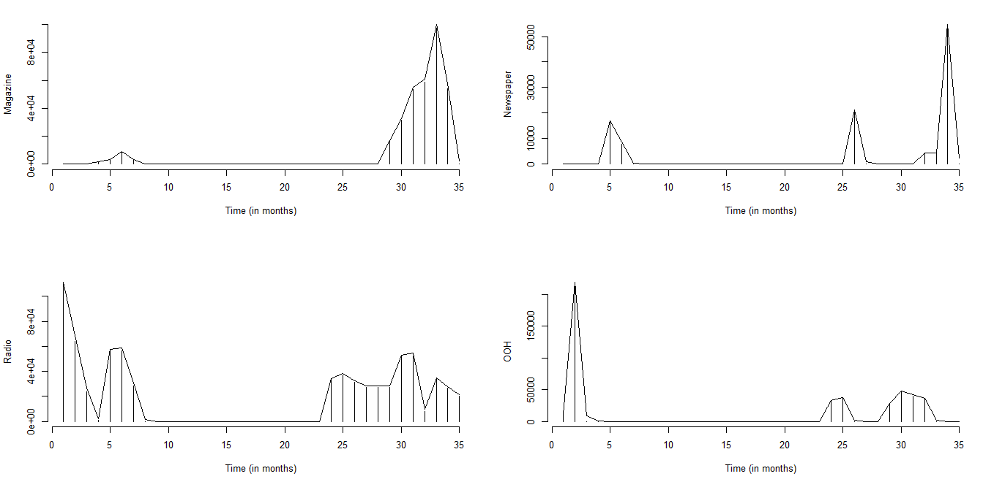
Adstock plot

Slide 27
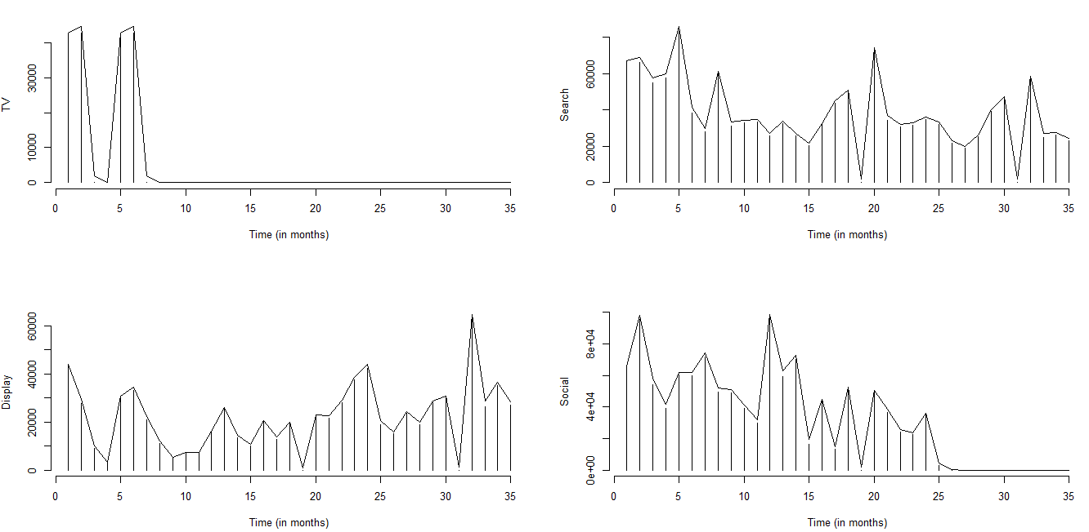
Adstock plot

Slide 28

Marketing Mix Model
$$Sales= a_{0}+ a_{1}.Trend+ a_{2}.Distribution+\sum_{i=1}{b_{1}.f({Advertising}_{i}|α_{i})}$$

Slide 29
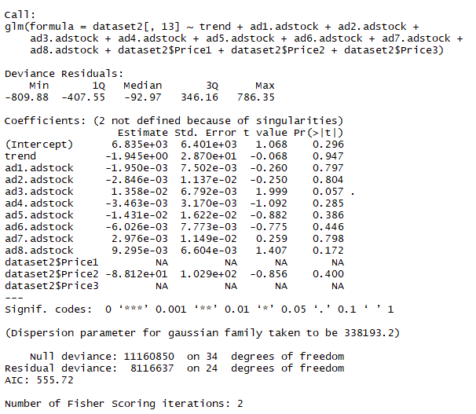
Summary of Model
MSE = 388761 by K fold CV @ K =2

Slide 30
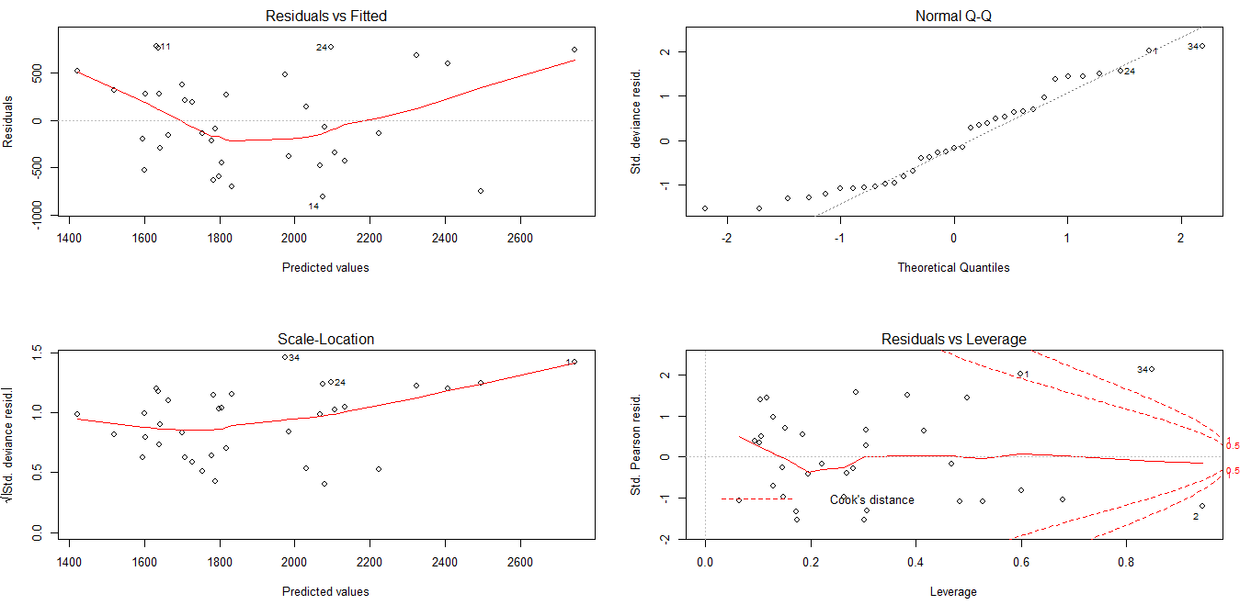
Model Diagnosis

Slide 31
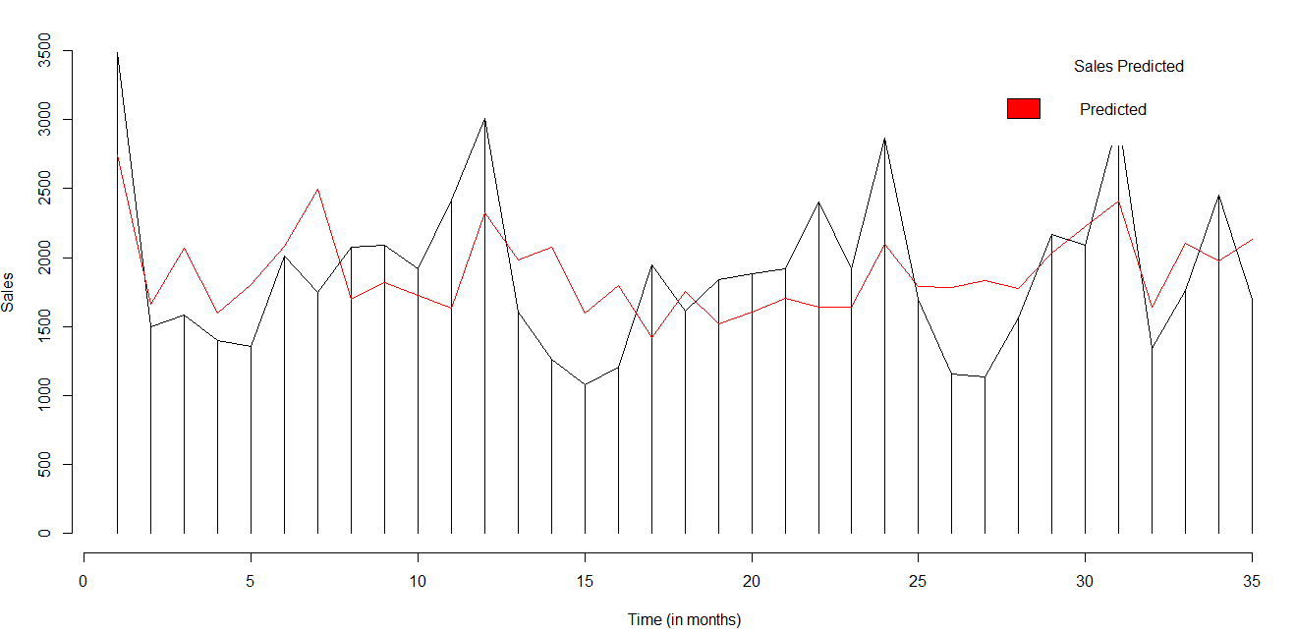
Sales vs Sales_Predicted

Slide 32

Roas
Roas is Return on Ad Spend
$Roas=\frac{Sales}{\sum_{i}{Adspend}}$

Slide 33
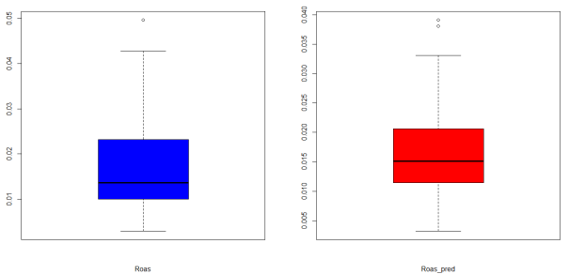
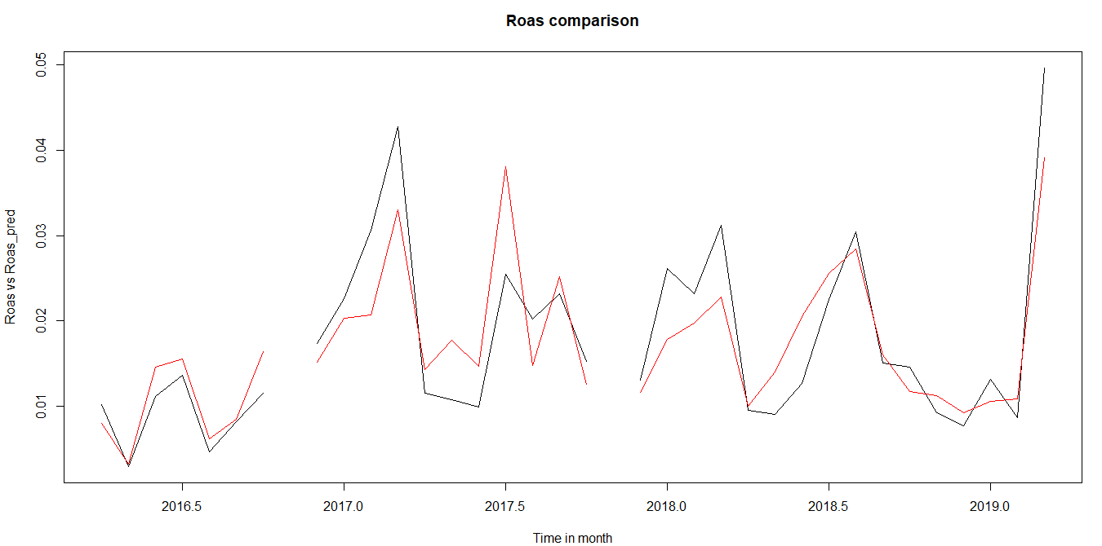
Roas vs Roas_predicted

